Slide 1

Powering up your FME Workspaces with Python
The Peak of Data Integration 2025
con terra GmbH

Slide 2
Housekeeping
Three hour training
Break from 10:30 - 10:45 am
Lunch from 12:00 - 1:00 pm
Plenary at 1:00 pm
Training environment with FME in Strigo
Course material will be available on the FME Knowledge Base after the course
Data and workspaces on Github FMEData

Slide 3


Bernd Mertens
Tino Miegel
Software Engineer con terra GmbH
Technology Lead Division con terra GmbH

Slide 4

Strigo Training Platform
Navigation pane
My lab
Notes:
Strigo is the application I am using to present the course.
The icons on the left let you access the different sections of the training, including viewing the course slides, my screen to view demonstrations, and your lab to access FME for the hands-on exercises.
You do not need to have FME installed on your own computer for this course.
The "Raise hand" is mostly used for quick polls, like asking if anyone needs more time on a lab exercise.
If you need help, just ask in the chat or use the "call for assistance" button.

Slide 5
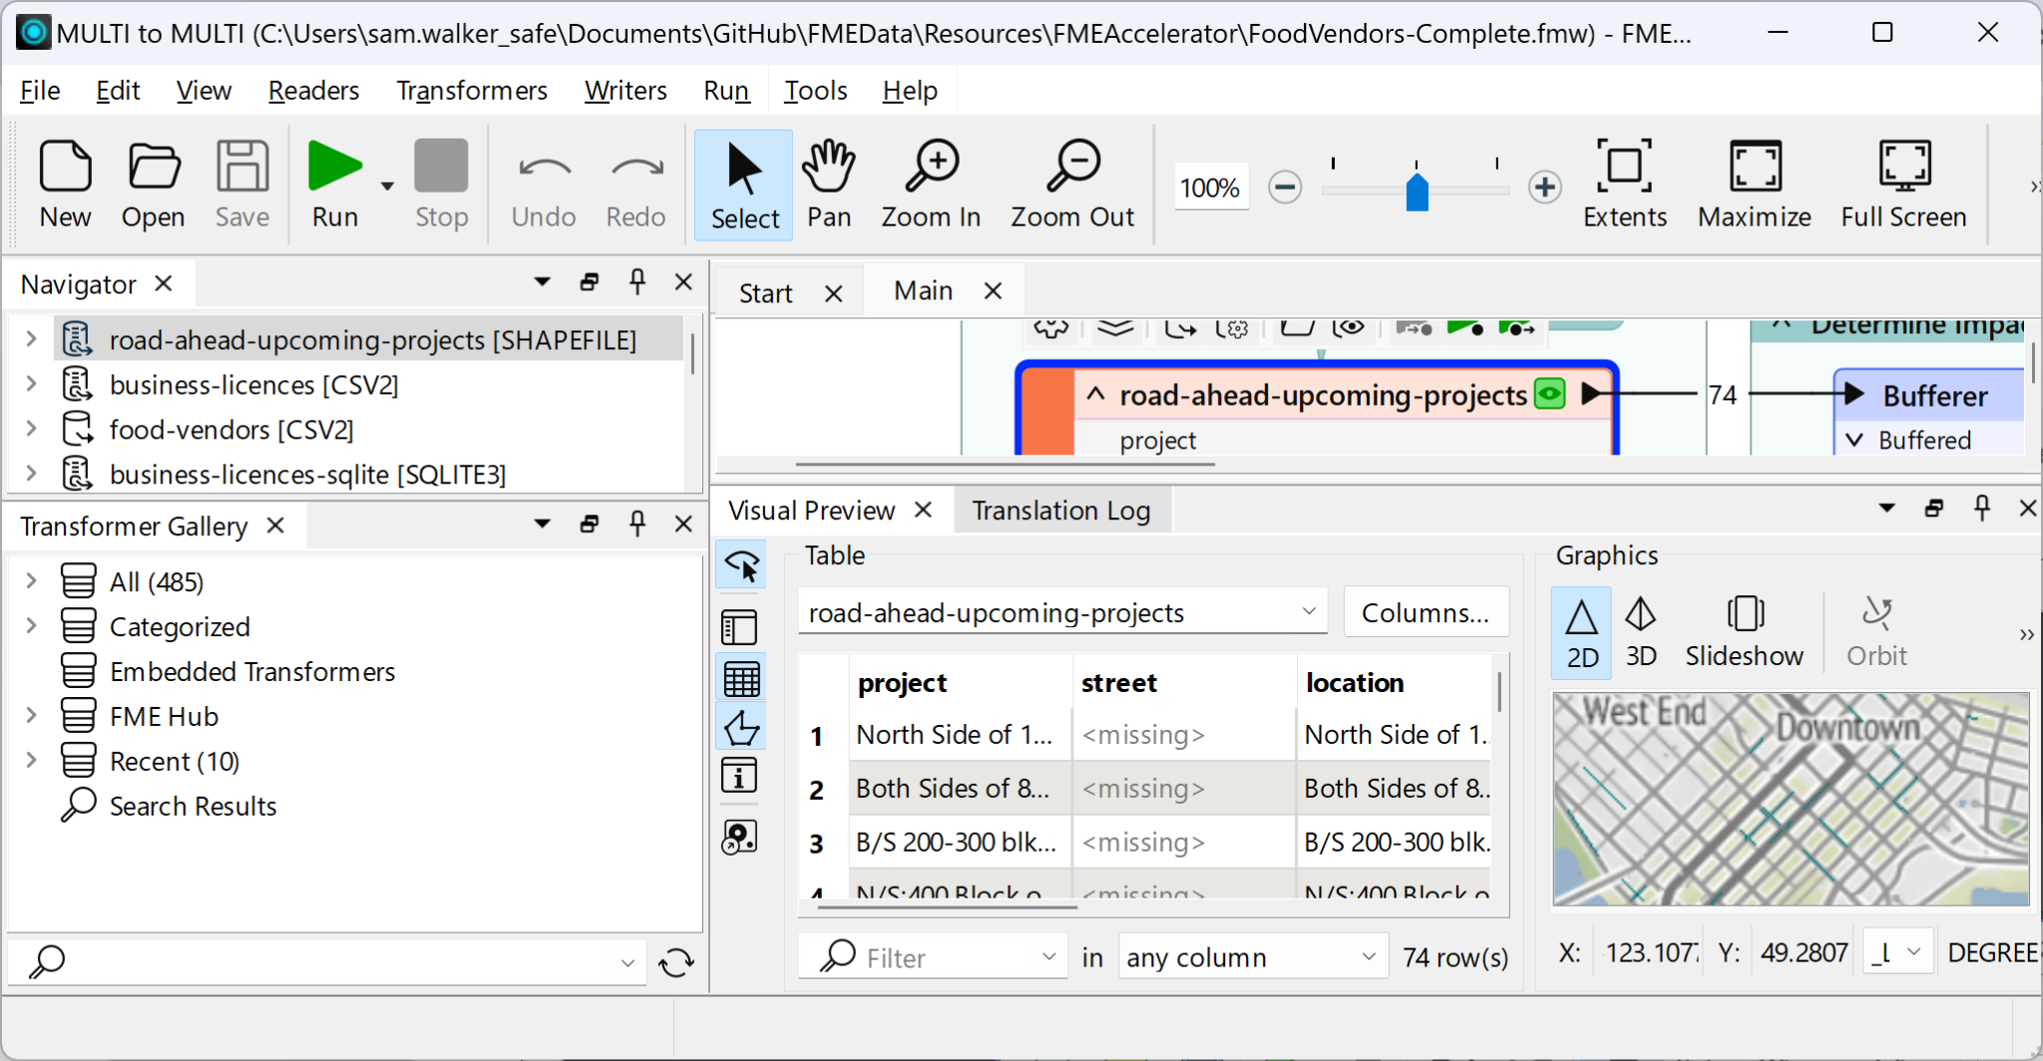
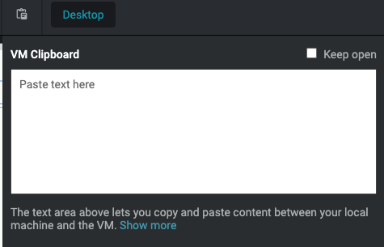
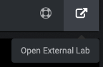
Copy & paste
Open lab in a new tab
Notes:
Copy-pasting into and out of the labs is a two-step process.
When copy-pasting something from your machine to the lab, you must first paste the text into the lab clipboard.
You'll then be able to paste the text within the lab.
The "open lab in a new tab" button will open your lab in a separate window, which is useful if you want to view what I'm presenting at the same time you are working in your lab.
However, I only recommend using this option if you have two monitors, or a very large monitor.
We've also designed the workshop so you don't need to view the lab while I'm presenting.

Slide 6
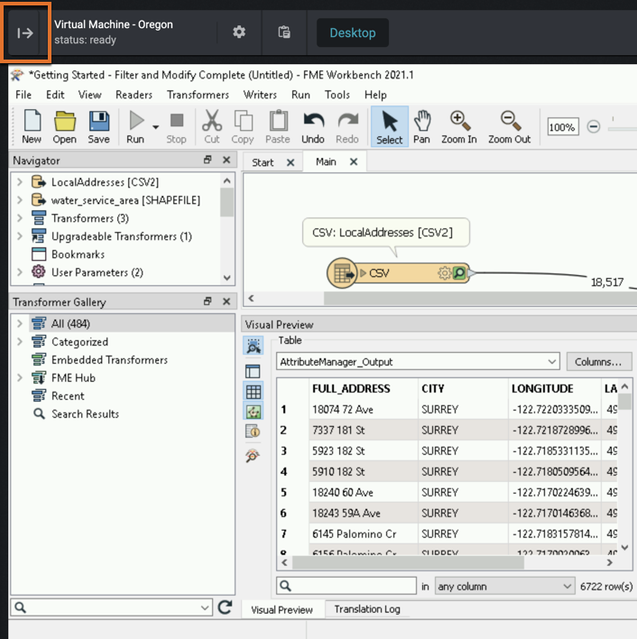

Lab
Screen too small?
Click on Lab icon, then:
Windows: Press Ctrl and -
Mac: Press ⌘ and -
Chrome OS: Press Ctrl and -
Can’t see exercises?
Click on top-left
VPNs/work network issues
See TA or presenter
Notes:
When you are in the lab, you can increase the size of the lab desktop by clicking on the Lab icon and then hitting CTRL and the minus sign.
If you don't see the exercises, you can expand the exercise tab by clicking on the arrow button at the top left of the lab.

Slide 7

Scripted Parameter Startup / Shutdown Scripts Python Transformer Handling list attributes FME Web Services Beyond FME Form
Agenda

Slide 8

Let‘s explore FME and Python
Section 1

Slide 9
What is Python?
Python is a scripting language.
Object oriented
No compiling or linking
Fast (“quick & dirty”) programming and prototyping
Name: Developer van Rossum is a huge fan of Monty Python’s Flying Circus

Slide 10
Why Python?
Free, powerful and flexible
Platform independent
Automatic Garbage Collector
Capable of being integrated
e. g. FME, ArcGIS, Blender
Extensive documentation and tutorials
www.python.org

Slide 11
Python Basics
Get a python shell with #> <FME dir>/fme.exe python
Run a script with #> <FME dir>/fme.exe my_script.py
Basics
> 1+1
> ”1” * 5
> dir()
> values = [1,2,3,4,5]
> print(values)
Notes:
FME 2022 doesn't add the install directory to the PATH anymore!

Slide 12

Please work on Excercise #1
Connect to your personal training instance
Try out some basic Python commands

Slide 13
FME meets Python
Section 2

Slide 14
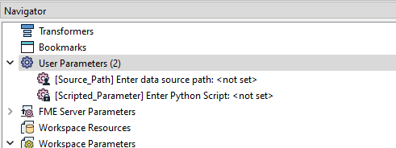
Published Parameters
Published Parameter are parameters which are set before runtime.
Examples:
Reader- / Writer file sources/ targets
Coordinate systems
Transformer parameters
Workspace Settings
Logfile

Slide 15
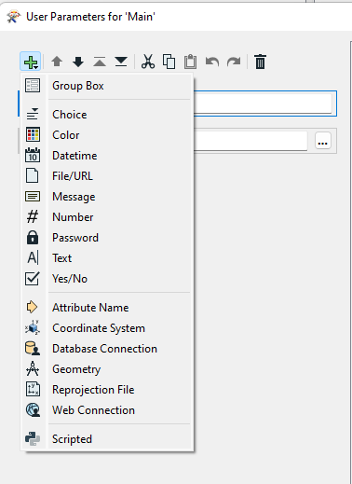
Scripted Parameter
Value is either Python or TCL script
Order of execution:
Scripted Parameter (in order)
Startup Script
FME Process
Shutdown Script
Allows usage as Reader parameter

Slide 16
Scripted Parameter
Last line with return statement to hand value to FME process
Access of Published Parameter
New: fme.macroValues[‘Parameter_Name‘]
Old: FME_MacroValues[‘Parameter_Name‘]

Slide 17
FME Objects & Plugin API
FME Objects API
Library containing FME functionality
Plugin API
Develop Readers, Writers, Formats, Transformers
Uses FME Objects
Documentation
https://docs.safe.com/fme/html/fmepython/index.html
Python FME Objects / Python FME Webservices API
https://safe.com/documentation

Slide 18
fmeobjects
Central module fmeobjects
Code statement: import fmeobjects
Many classes for different FME aspects:
FMEFeature, FMEGeometry, FMELogfile, …

Slide 19
FMELogFile()
Create your own log messages (also on FME Flow!)
Create a logger object
logger = fmeobjects.FMELogfile()
Don’t forget to import fmeobjects
Create a log message
logger.logMessageString(message, severity)

Slide 20
Using print()
print('Info message',[file=sys.stdout])
print('Warn message',[file=sys.stderr])
=> Only for rapid debugging
For optimal use → fmeobjects.FMELogFile()

Slide 21
Severity Types
Optional: Log-Level (FME Severity Level)
fmeobjects.FMELogFile().logMessageString('Message', fmeobjects.FME_WARN)
You can‘t use fmeobjects.FMELogfile()
Simple workaround: with open(fme.logFileName, "a") as logfile: logfile.write("Processing Shutdown Script\n")

Slide 22
Severity Types
Severity Levels
0 FME_INFORM black
1 FME_WARN blue
2 FME_ERROR red
3 FME_FATAL red
4 FME_STATISTIC black
5 FME_STATUSREPORT N.A.

Slide 23
Shutdown Script
Runs after the process has finished with either SUCCESS or FAILURE
Post-Processing
Everything FME related is done by then
Use cases
Move / copy / pack result
Call external modules (e. g. Arcpy)
Custom logging

Slide 24
Shutdown Script
Access published parameters and FME system parameters with the module fme
fme.cpuTime, fme.cpuUserTime, fme.featuresRead, fme.failureMessage, fme.logFileName, fme.macroValues, fme.status, …
All shutdown script variables
https://docs.safe.com/fme/html/FME_Desktop_Documentation/FME_Desktop/Configuration/FME_END_PYTHON.htm

Slide 25
Please work on Excercise #2
Python Startup Script
Problem:
To clarify things, you want to add your own custom log messages to the FME Logfile.
Solution:
Use the logger facility FMELogFile() and create messages with different log levels.

Slide 26
Feature Manipulation with Python
Section 3

Slide 27
fmeobjects - FME Feature
import fmeobjects
# Instantiate a new feature
myFeature = fmeobjects.FMEFeature()

Slide 28
fmeobjects - FME Feature
myFeature.setAttribute("Identification", 123)
myFeature.setAttribute("Name", "FME Lizard")
myFeature.setAttribute("List", ["FME Desktop", "FME Server"])
myFeature.removeAttribute("Name")
myFeature.removeAttrsWithPrefix("Any Prefix")

Slide 29
Working with geometries
Two steps to create a feature with a geometry
Create geometry
Apply geometry to a FME feature
Step 1:
Create a point geometry point = fmeobjects.FMEPoint(0,0)
Create a line geometry line = fmeobjects.FMELine() line.appendPoints([(-20,-20),(20,-20)])

Slide 30
Working with geometries
Step 2:
Assign geometry to Feature
Point feature = fmeobjects.FMEFeature() feature.setGeometry(point)
Line feature2 = fmeobjects.FMEFeature() feature2.setGeometry(line)

Slide 31
More Feature Functions
getAllCoordinates()
getGeometryType()
getDimension()
getCoordSys()
...

Slide 32

Python in FME Workspaces

Slide 33
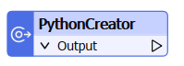
PythonCreator
No input port!
Usage
More control over creation of features compared to Creator transformer
Create your own Reader

Slide 34
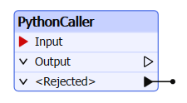
PythonCaller
Consumes FME features:
Attribute manipulation
Geometry manipulation
Usage
Run any python code
Create advanced „Custom“ Transformers
Detailed logging, filtering or creation of features

Slide 35
Python Transformer
Both Transformers allow Python code execution during the FME process.
Implement your code
Directly in Transformer
As external script file, e. g. myPythonLogic.py
Use the PythonCaller to manipulate existing features (has an input port)
Use PythonCreator to create features from scratch

Slide 36
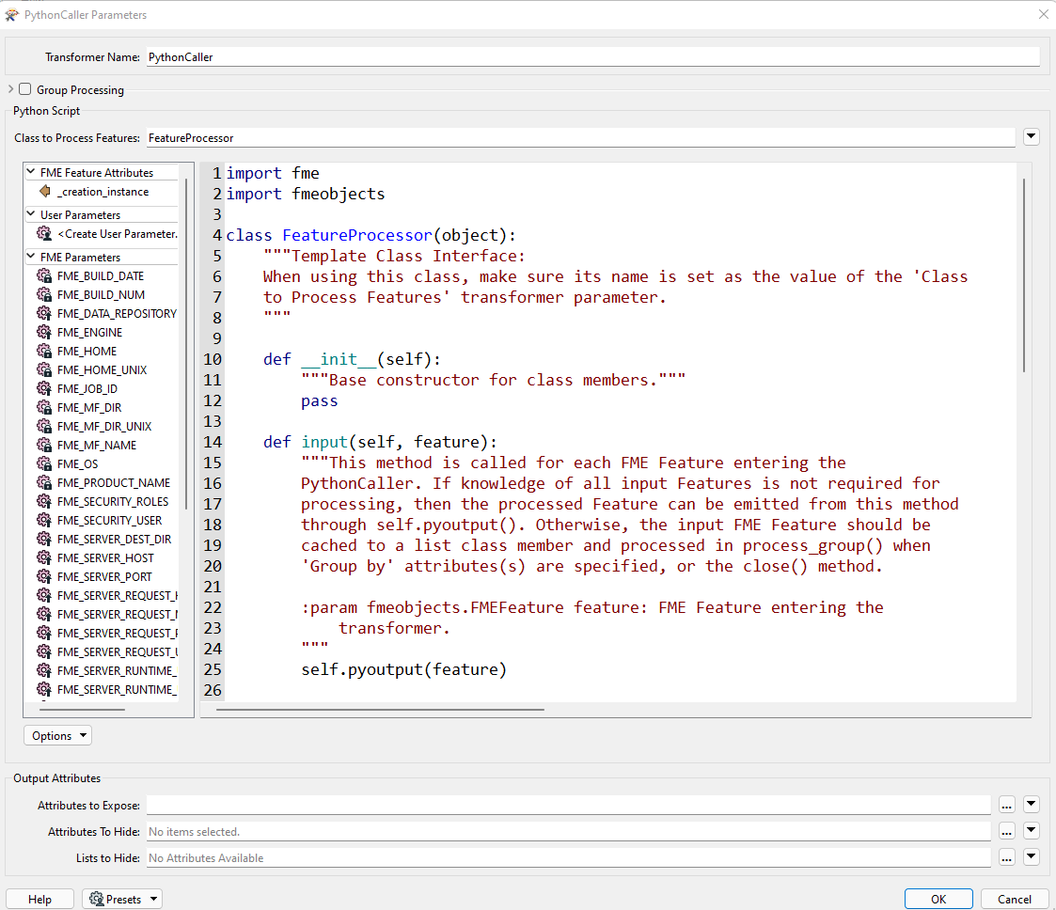
Python Transformer
Variant A: Use FME Editor for source code
FME Editor uses spaces indentation!
Syntax highlighting
Easy access of Parameters (Published, Private, System) Search & Replace
But: No IntelliSense!

Slide 37
Python Transformer
Variant B: External Script Files
Class to process features modulename.Class => modulename.py
Benefit: You can use your favorite editor or IDE
Search path: <FME_INSTALL_DIR>\FME\transformers <FME_INSTALL_DIR>\FME\python
Directory of workspace file (*.fmw) ($FME_MF_DIR)
Add your own directories with sys.path.append ! -> Startup Script

Slide 38
Python Transformer
Python Script
Python script / code
Class to Process Features
Attributes To Expose
Attributes To Hide
Lists To Hide

Slide 39
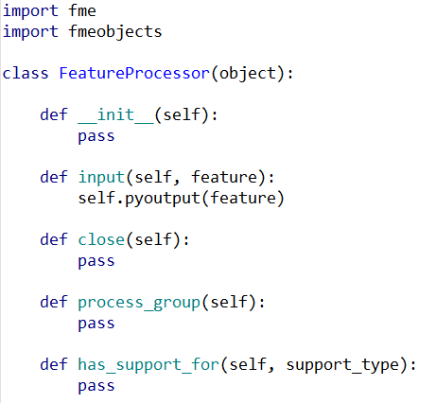
Class (1/2)
Defined by the keyword class
Constructor / function with reference to object
FME hands over feature via input(self,feature)
FME calls close(self) after last feature

Slide 40
Class (2/2)
Return feature handle to FME with self.pyoutput()
Usable in both input() and close() method
Never access the feature object after pyoutput()!
Keyword pass if a method is empty otherwise

Slide 41
Please work on Exercise #3
Calculate Statistics
Use the different PythonCaller methods to calculate your own statistics over different features

Slide 42
Working with Lists
Section 4

Slide 43
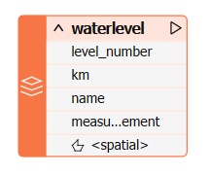
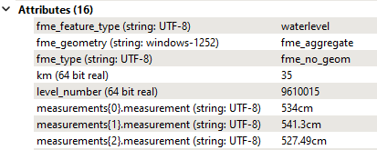
Lists in FME
Multiple values „in“ a single attribute per feature
Note the difference
Notation via { } in FME
Notation via [ ] in Python
setAttribute() / getAttribute() performs mapping

Slide 44
FME Lists in Python
feature.getAttribute('measurements{}.measurement')
feature.setAttribute('measurements{}.measurement',[21,22,23])
feature.getAttribute('measurements{2}.measurement')
feature.setAttribute('measurements{2}.measurement', 123)
i = 2
feature.getAttribute('measurements{'+str(i)+'}.measurement')

Slide 45
Loops with FME Lists in Python
# „Normal“ for-Loop
myList = feature.getAttribute('_list{}._creation_instance')
for element in myList:
print(element)
# Iteration with index
myList = feature.getAttribute('_list{}._creation_instance')
for i,element in enumerate(myList):
print(i,element)

Slide 46
Please work on Excercise #4
Working with list attributes
Problem:
Non numeric list elements can’t be processed by some list transformers
Solution:
Use Python to iterate over the list elements and clean up the values

Slide 47
FME Web Services API
Section 5

Slide 48
Named Connections
Preferable storage of user credentials to external services
Well integrated into FME Flow
Encrypted password storage
Keeps confidential data out of workspace files

Slide 49
Please work on Excercise #5
Use the FME Connection Manager

Slide 50
Beyond FME Form
Section 6

Slide 51
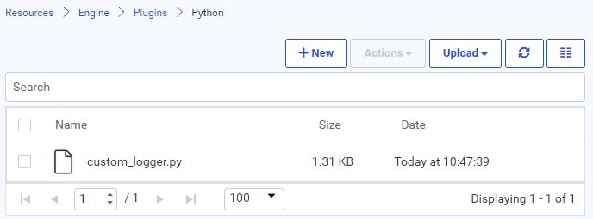
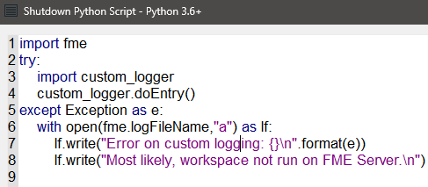
Reusing Python Code in FME Flow
Save your Python code as *.py
Upload it to FME Flow
Resources/Engine/Plugins/Python/ → Reusable in every workspace
Repository folder → Reusable in every repository workspace
Import module and execute code

Slide 52
Using additional Libraries
Check if already included
User standalone Python interpreter and PIP
(Use FME PIP)
<Danger> → Version conflicts possible

Slide 53

Python is a powerful way to extent FME…
..but don’t reinvent the wheel!

Slide 54
Thank You
Bernd Mertens & Tino Miegel
con terra GmbH
b.mertens@conterra.de & t.miegel@conterra.de

